Slide 1

AN ANALYSIS OF CURRENT INVENTORY IN:
NEW YORK CITY

Slide 2
SCOPE OF PROJECT
DATA POINTS
Listing ID
Name
Host ID
Host Name
Borough (Neighborhood Group)
Neighborhood
Latitude
Longitude
Room Type
Price
Minimum Nights
Number of Reviews
Last Review Date
Reviews Per Month
Number of Listings per Host
Availability (Last 365 Days)
Spreadsheet with 48,895 Listings
16 Data Points Per Listing
TASK: Exploratory Analysis
Formulate questions & hypotheses
Answer these with multiple tools
Visualizations
Statistical Analysis (including p-value tests)
Query-based insights (SQL)
Identify trends & areas of concern
Establish relationships between variables
Notes:
TALKING POINTS
Almost 50K Listings
16 Data Points for Each
Tasked me with: Exploring Data
I have a limited amount of time with you, we let’s do initial findings in one area.
TO DO
- Highlight which ones focused on.

Slide 3
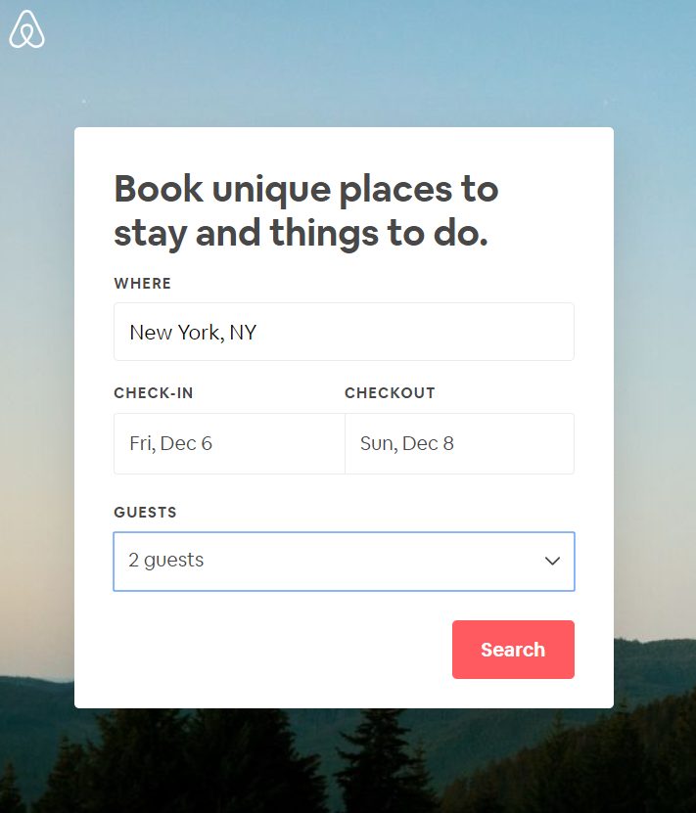
LET’S BOOK A WEEKEND TRIP TO NEW YORK CITY
Notes:
How to choose which area? Let’s think like a customer.

Slide 4
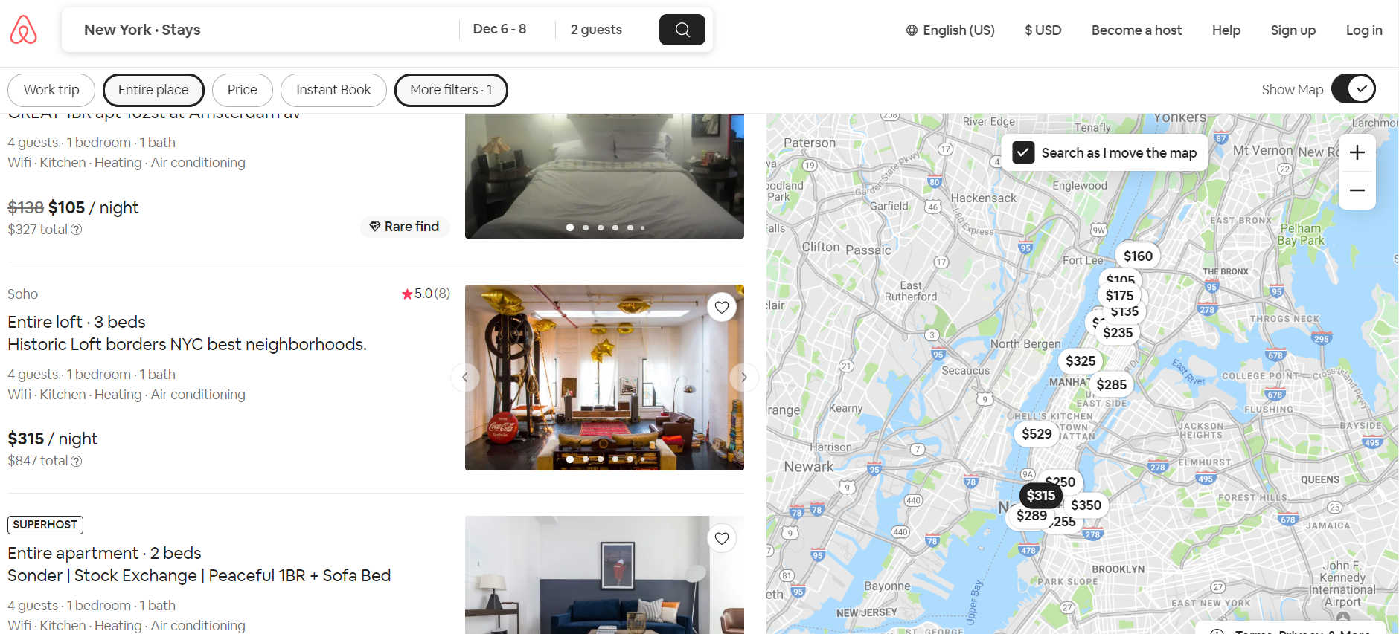
A customer searches through recommended options…

Slide 5
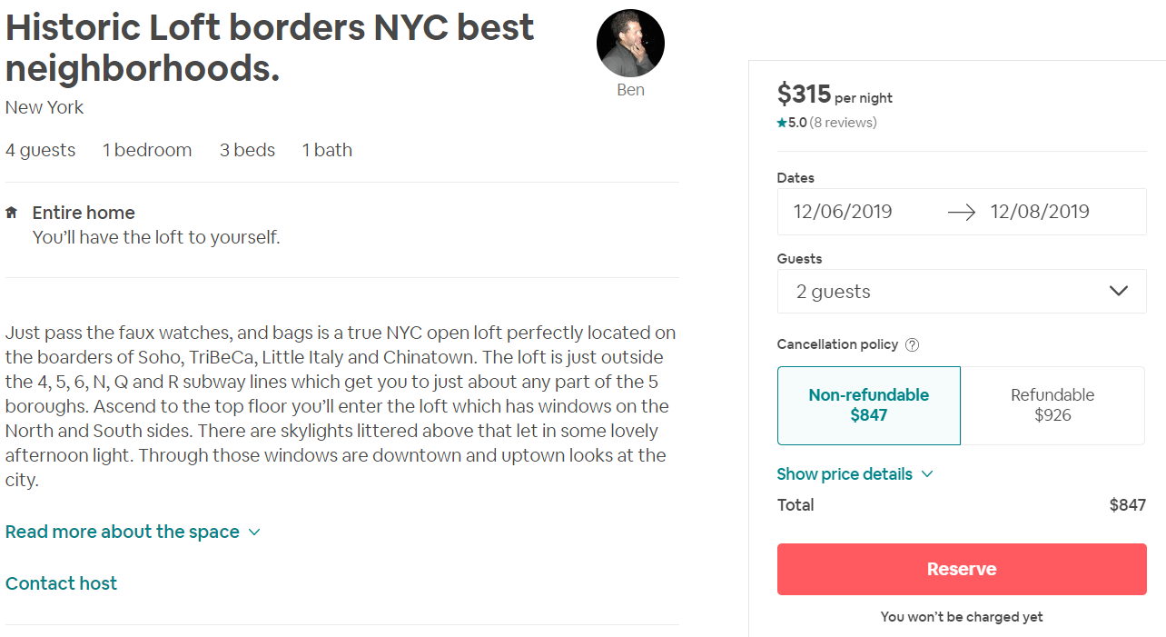
… until he finds the one.

Slide 6
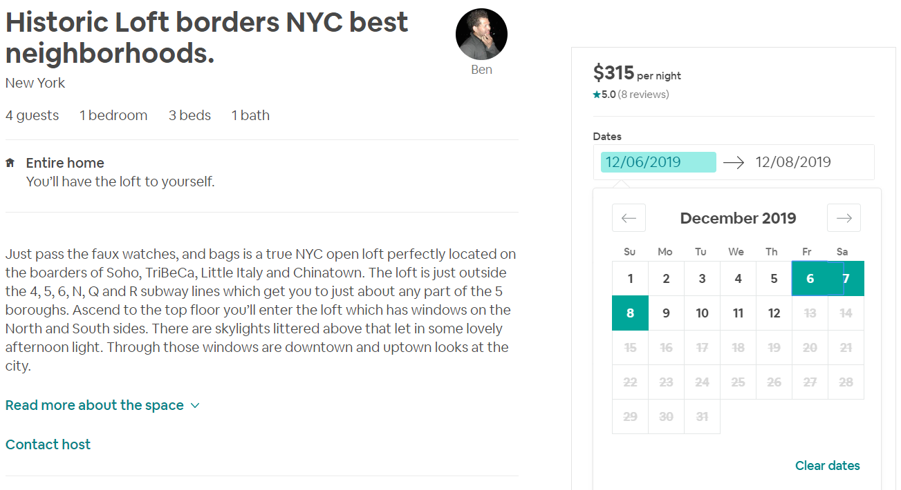
However, he changes his date but there is no availability soon…

Slide 7
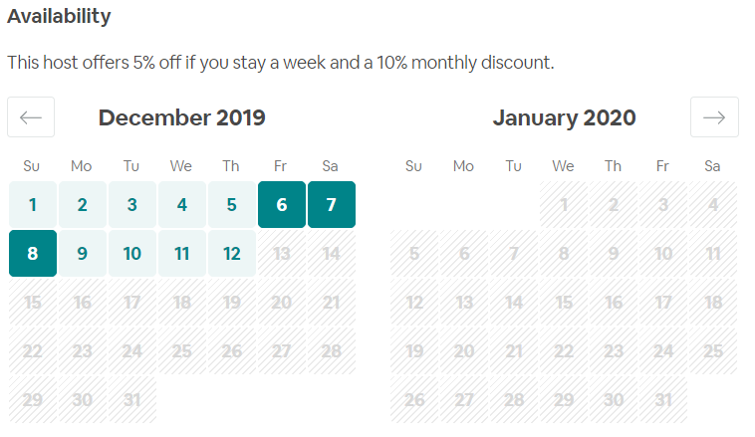
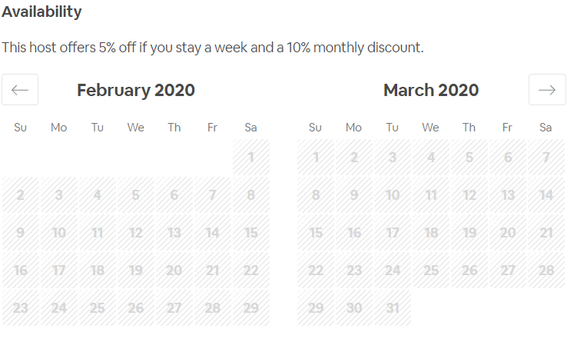
… or ever again.
Notes:
PATHS
Continue Search. Waste time, add stress. But we get a sale
Stop Search. No sale for Airbnb

Slide 8
Let’s look at: AVAILABILITY
Why?
A review of New York City’s inventory can provide insight into possible host behavior patterns of similar and/or emerging cities.
Notes:
WHAT ARE WE DOING TODAY
Question the number of listings that we have
Identify patterns in availability in New York City, and more importantly patterns that other similar cities may have.
NOTE – We only have limited time today so this will show you initial insights into what we can potentially do if would like me to move forward with this project.

Slide 9
ACTIVE VS. INACTIVE
CLAIM 1: Majority of Listings (75%) are available at least 1 day / year
Result of Hypothesis Test: Claim rejected with 95% confidence.
Unexpectedly, 36% of listings are not available (“inactive”).
What IS available?
Status | Number of Listings | % of Total
Active (Available 1+ Days) | 31,362 | 64%
Inactive (Available 0 Days) | 17,533 | 36%
TOTAL | 48,895 | 100%
Notes:
TALKING POINTS
Majority of Listings are available at least 1 day per year.
Hypothesis Test rejects this claim
Within the sample give, 36% of listings are inactive.
So… the almost 50K listings and now slightly above 30K.
At least 1 day is VERY Generous so we should dig deeper.
MOVING FORWARD >> WE HAVE 2 PATHS TO EXPLORE: ACTIVE VS INACTIVE LISTINGS
NOTE on CLAIM: p-value was a whole bunch of 0000.

Slide 10
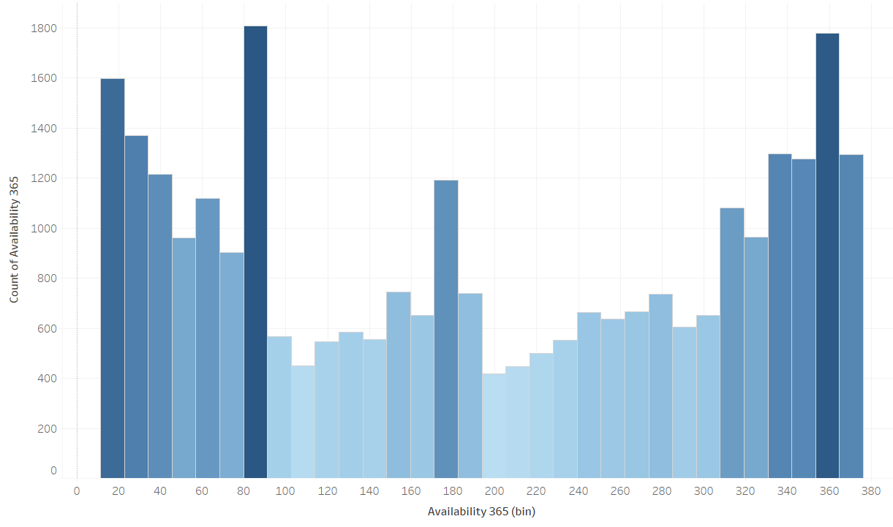
HOW AVAILABLE IS A LISTING?
CLAIM 2: 50% of active are available 50+% of Year (183 days )
Result of Hypothesis Test: Claim rejected with 95% confidence
46% of Listings are available at least half the year
Availability | Listing Count | % of Total
Less Than Half the Year (1-182) | 17,052 | 54%
More Than Half The year (183-365) | 14,310 | 46%
TOTAL ACTIVE | 31,362 | 100%
Notes:
Histogram shows that the distribution is pretty even, but with higher density bins on the first half of the graph

Slide 11
COMPARING LEVELS OF AVAILABILITY
Define Attribute: Availability Level
Availability (Days) | Attribute: Availability Level
0 | Unavailable
1 -182 (Less than 50% Year) | Low Availability
183 - 365 (More than 50% Year) | High Availability
Proportion of Total Listings
Attribute: Availability Level | Listing Count (Source: SQL) | % of Total
Unavailable | 17,533 | 36%
Low Availability | 17,052 | 35%
High Availability | 14,310 | 29%
TOTAL | 48,895 | 100%
Notes:
From the first hypothesis, we decided to split the bookings into active vs. inactive.
Now, let’s do a second attribute that further splits the active ones: Let’s say Availability level is Unavailable, Los Availability (less than 6 months)
What do we find here… only 29% of the total inventory is available at least 6 months!
So, we went from almost 50K listings, to only 30K of those being active, and 14K being available at least half the year.

Slide 12
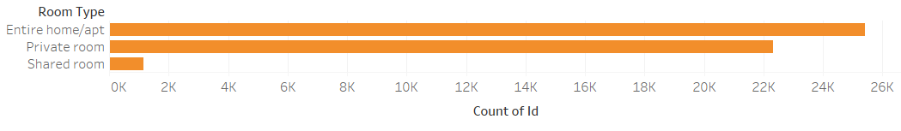
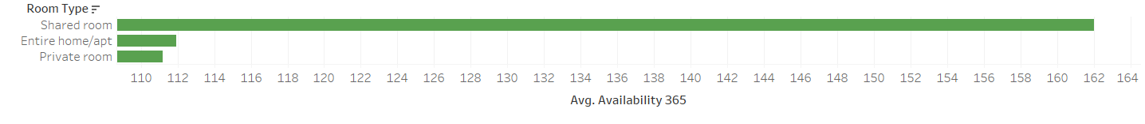
AVAILABILITY BY ROOM TYPE
What is the most frequently listed room type?
How do room types compare on average available days per year?
As expected, shared rooms are the most available. But surprisingly, entire apartments have more available that private rooms.
Notes:
Shared Rooms are the most available as expected, but entire apartments are more available than private rooms.
From previous findings, let’s apply the some metrics.

Slide 13
AVAILABILITY BY ROOM TYPE (cont.)
From initial findings,
let’s look at proportions at active status and availability level
Active Status
Availability Level (Active only)
Activity Status | Entire home/apt | Private Room | Shared Room | Grand Total
Active | 65% | 63% | 74% | 64%
Inactive | 35% | 37% | 26% | 36%
Grand Total | 100% | 100% | 100% | 100%
Availability Level | Entire home/apt | Private room | Shared room | Grand Total
High Availability | 46% | 44% | 56% | 46%
Low Availability | 54% | 56% | 44% | 54%
Grand Total | 100% | 100% | 100% | 100%
Entire Home and Private follow similar proportion than total, but Shared Rooms are proportionally more active than the total. When listed, they stay in the platform.
Surprisingly, Entire home/apt and Private Rooms follow the same availability patterns. They are almost equally listed, active, and available.
Notes:
Shared Rooms are the most available as expected, but entire apartments are more available than private rooms.
From previous findings, let’s apply the some metrics.

Slide 14
AVAILABILITY BY ROOM TYPE (cont.)
From initial findings,
let’s look at proportions at active status and availability level
Active Status
Availability Level (Active only)
Activity Status | Entire home/apt | Private Room | Shared Room | Grand Total
Active | 65% | 63% | 74% | 64%
Inactive | 35% | 37% | 26% | 36%
Grand Total | 100% | 100% | 100% | 100%
Availability Level | Entire home/apt | Private room | Shared room | Grand Total
High Availability | 46% | 44% | 56% | 46%
Low Availability | 54% | 56% | 44% | 54%
Grand Total | 100% | 100% | 100% | 100%
Entire Home and Private follow similar proportion than total, but Shared Rooms are proportionally more active than the total. When listed, they stay in the platform.
Surprisingly, Entire home/apt and Private Rooms follow the same availability patterns. They are almost equally listed, active, and available.
Notes:
Shared Rooms are the most available as expected, but entire apartments are more available than private rooms.
From previous findings, let’s apply the some metrics.

Slide 15
HOST PATTERNS
Average number of listings per host: 10.34 *
For multiple-listing hosts (at least 2), average is: 21.96*
Total Number of Hosts: 21,809*
Total Multiple-Listing hosts: 4,416*
20% of Hosts have multiple listings
Total Listings from Multiple-Listing hosts: 13,969
Total Active Listings: 31,362
45% of listings from multiple-listing hosts
* Source: SQL, Inactive Listings (Availability_365 = 0) Removed
Notes:
Average number of listings per host: 7.14
Quite high. Is it perhaps an indication of commercial usage of platform.
For multiple listing hosts,

Slide 16
CONCLUSIONS
Conclusion | Potential Application / Next Steps
29% of Total Inventory is Inactive | Why? Does it take less resources to re-activate a listing or source a new one?
Less than half of the Active(46%), is available over 6 months of the year | What is the effect on customer experience? Should we review resources allocated to encourage more availability from existing listings?
Entire Apartments are more frequently listed than private rooms | In a city where affordable housing is of concern, is this expected? Does this unintentionally support the argument for curbing short-term rentals? What are we doing about it?
Shared rooms are more likely to be remain active, but also the least frequently listed. | Is this a result of demand for this room type within market? Should we invest in this type of listing or not?
Entire homes follow similar inventory patterns and availability patterns than Private Rooms. | Assuming there should be some difference, is this a sign of too much Entire home inventory or a sign of opportunity to increase Private Room inventory.
The average listing count per host is 10 list, but it goes up to 21 for hosts multiple listings | Indication of commercial usage in market. How are we dedicated resources in host acquisition to attract different types of hosts? A bigger question, is this in line with vision?
20% of hosts have multiple listings. These hosts control 45% of the inventory.
Are there observations unique to New York City or can they do they apply to similar and/or emerging cities?
Notes:
Most important highlighted

Slide 17
MORE INFORMATION ON THIS PROJECT:
TOOLS USED:
MICROSOFT EXCEL
STRUCTURED QUERY LANGUAGE (SQL)
TABLEAU
GITHUB
TABLEAU PUBLIC
LINKEDIN
Notes:
https://public.tableau.com/profile/rachelle.perez#!/vizhome/airbnb_nyc_15729029642910/Top10NeighborhoodsbyBorough?publish=yes

